Slide 1
Tata Data
Visualization Presentation

Slide 2
Introduction
Good day and welcome. In this presentation, I will take through our company’s sales performance for the years 2010 and 2011.
I appreciate the oppoturnity given to me to be able to dig into this data and learn more about the store’s performance.
Thanks for the questions you threw my way, they really helped guide what insights you wanted from this analysis.

Slide 3
Thought Process
I assure you that I took all the necessary steps to ensure that this analysis is accurate and correct.
I cleaned the provided data by removing all negative values in the Unit Price and Quantity columns, I filtered all the data as required for visualization.

Slide 4
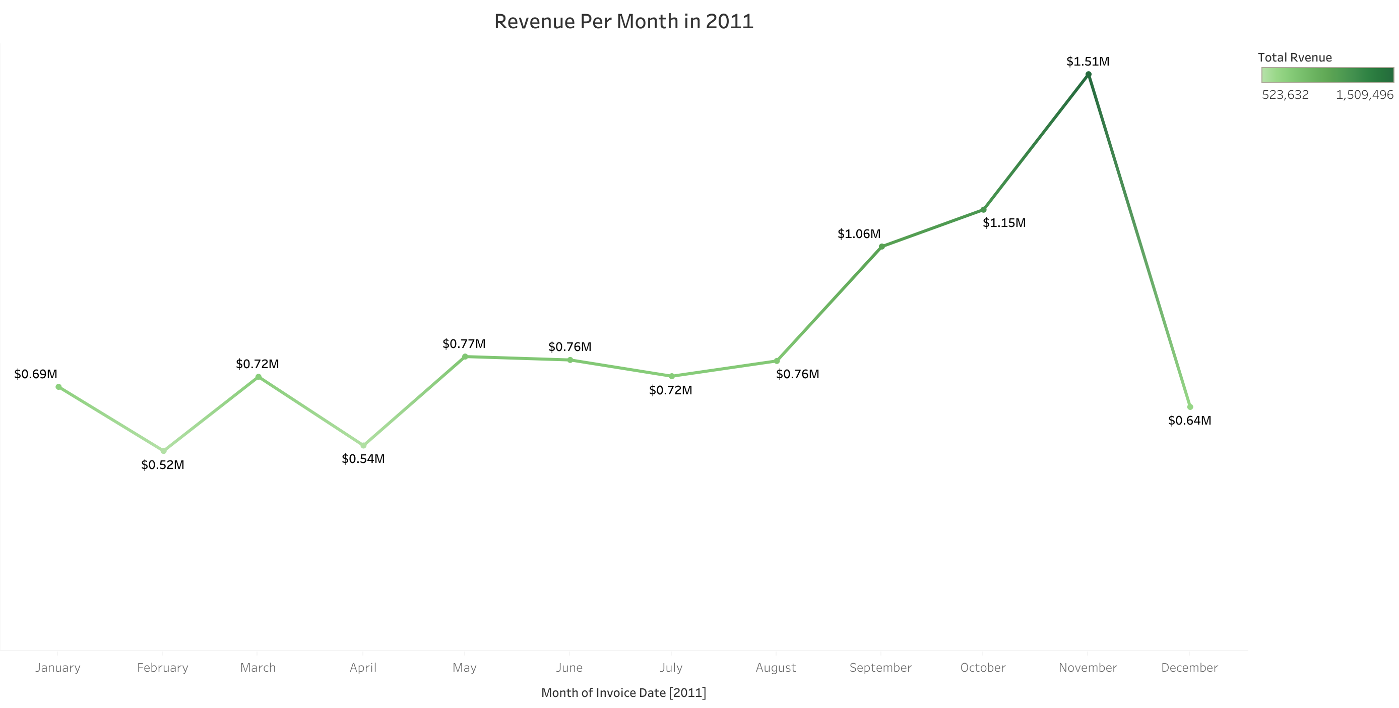
Revenue per month in 2011
The first 8 months had stable monthly revenues with an average of $685,000.
There was a significant increase in revenue from September peaking at $1.51 million in November.
The trend line from August to December shows the impact of seasons on retail store sales.

Slide 5
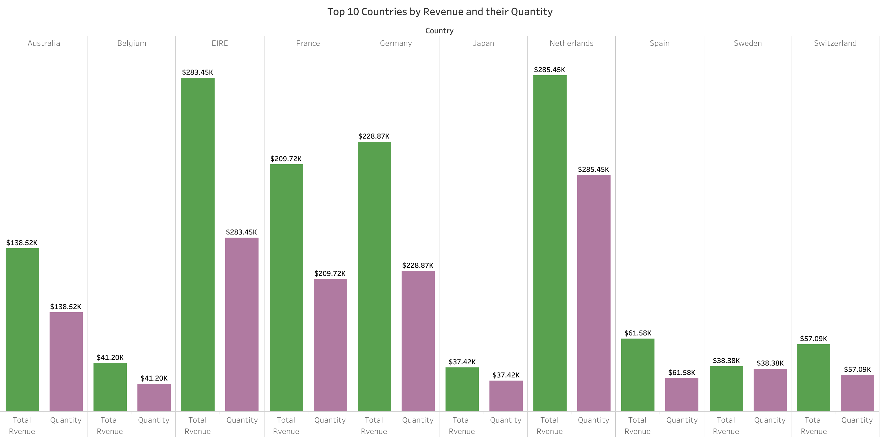
Top 10 Country by Revenue and their Quantity
This chart represents the top 10 countries in revenue and the quantities bought in these countries except The United Kingdom.
These countries are areas with the biggest potential for increased revenue. Management should really zoom in on them for marketing strategies.

Slide 6
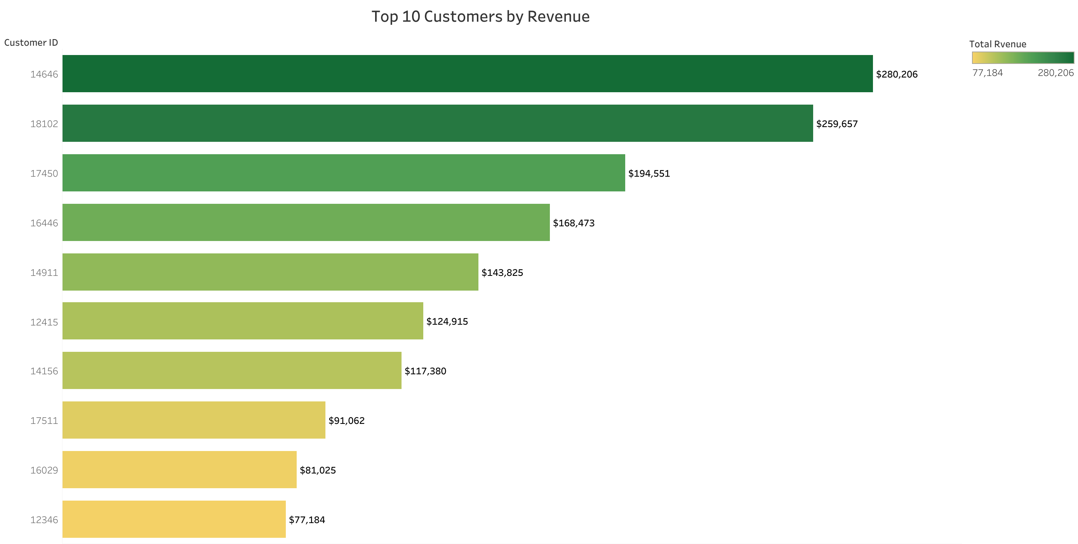
Top 10customers by Revenue
This shows the major difference between the top 10 customers in terms of revenue generated
The company can aim to strengthen the relationship with customers to increase customer loyalty, this can drive more sales and revenue to the company

Slide 7
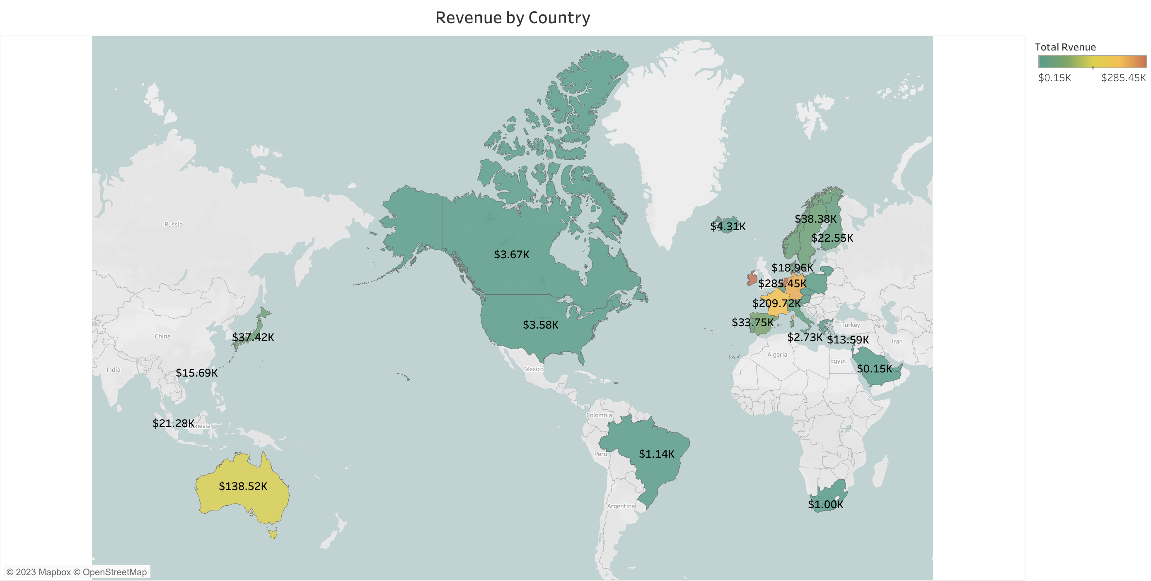
Revenue by Country
The map chart compares the revenue generated by each country except The United Kingdom.
This map reveals that majority of the sales occur only in European regions, with a small number of the American region along with Russia there’s no market for the items in Africa or Asia.

Slide 8
Recommendation
The company needs to devise plans for stocking and promoting seasonal items to boost sales when their demand rises.
The company should look closely at items that sell well during slower months and plan how to market these products.
﻿﻿The company should consider incentivizing top revenue-generating customers to strengthen the relationship with these customers.
The European market is ripe for expansion, and the company should focus on strategies to boost its presence there.

Slide 9
THANK YOU

